Slide 1
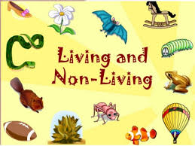

Slide 2
Features Of Living Things

Slide 3
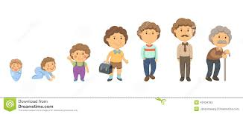
Living things grow in size

Slide 4
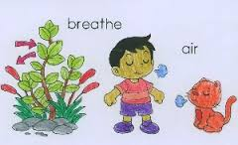
Living things breathe in air

Slide 5
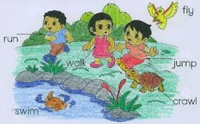
LIVING THINGS MOVE

Slide 6
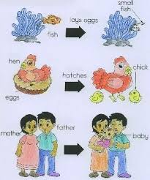
LIVING THINGS REPRODUCE AND PRODUCE BABIES

Slide 7
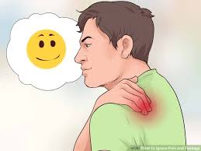
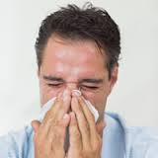
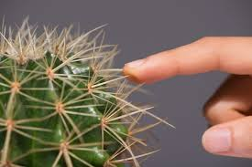
Living things feel, hot, pain and cold

Slide 8
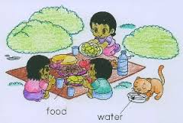
LIVING THINGS NEED AIR, FOOD AND WATER TO GROW

Slide 9
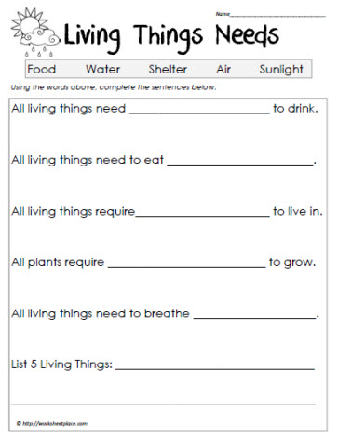

Slide 10
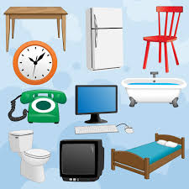
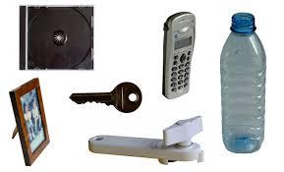
IDENTIFY THESE OBJECTS

Slide 11
DO ALL THESE OBJECTS
FEEL
?
  MOVE
BREATHE
GROW IN SIZE
REPRODUCE
NEED AIR,WATER AND FOOD TO GROW

Slide 12
THESE ARE ALL NON-LIVING THINGS

Slide 13
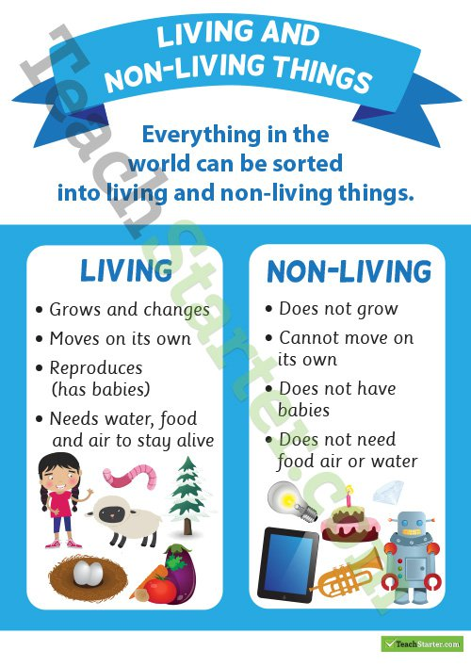

Slide 14


Slide 15


